Slide 1
To Git or Not to Git for Enterprise Development
Benjamin Day
@benday
Edward Thomson Microsoft @ethomson

Slide 2
Benjamin Day
Brookline, MA
Consultant, Coach, & Trainer
Microsoft MVP for Visual Studio ALM
Scrum, Team Foundation Server, Software Testing, Software Architecture
Scrum.org Classes
Professional Scrum Master (PSM)
Professional Scrum Developer (PSD)
Professional Scrum Foundations (PSF)
www.benday.com, benday@benday.com, @benday

Slide 3
Edward Thomson
Senior Software Engineer on Visual Studio Team
Version control tools, Git, TFS
Core contributor to libgit2
Git library used by GitHub, Visual Studio, Xamarin, Xcode
Professional Team Foundation Server 2013
http://www.edwardthomson.com, @ethomson

Slide 4
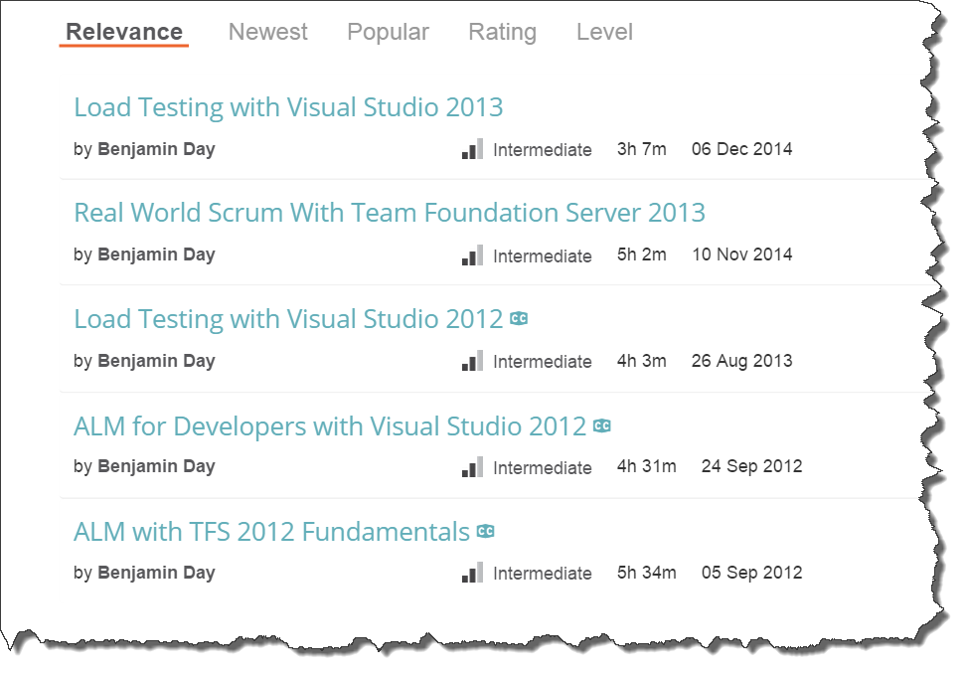
Got ?

Slide 5
What do we mean by “enterprise”?

Slide 6
Enterprise Software
Usually team that’s big enough to cause integration headaches
multiple teams
Traceability, governance, compliance, etc.
Reproducibility
Confidence
You probably do Releases rather than Continuous Deployment

Slide 7
TFS Version Control (TFVC) has handled the “enterprise” stuff for years.

Slide 8
Now you can do it with Git.

Slide 9
So what’s “enterprise Git”?

Slide 10
What’s Git?
Distributed Version Control System (DVCS)
Arguably the most popular DVCS
Written by Linus Torvalds, et al.
Initial release in April 2005
http://www.git-scm.com
Added to TFS in 2013

Slide 11
“Uhhh…what’s DVCS?”

Slide 12
Well, first…what’s Centralized Version Control?

Slide 13
Centralized Version Control
TFS, SourceSafe, Subversion, etc.
There's a central server
Central server governs the versions
User checks in changesets to server
Users have one version at a time

Slide 14
What’s DVCS?
Less or zero emphasis on central server
Each user has a clone of the repository
The clone has *all* the versions
User checks in to local repository
User pushes changes to the remote…maybe

Slide 15
Why Git?
Because light sabers are cool
You wanna be cool, right?
The cool kids use Git.
Effortless to work disconnected
Branching is (arguably) a lot easier

Slide 16
TFVC vs. Git

Slide 17
TFS Version Control vs. Git
TFVC
Git
One VC repository per Team Project Collection
The VC for a Team Project is really just a folder
Multiple solutions (*.sln) in the VC repository
Potentially lots of code
Potentially lots of unrelated code
Branches are folder-based
You might have multiple version in your local workspace simultaneously
Check-ins are immediately visible
Limited offline support
A typical "repo" is smaller
More like 1 or 2 solutions (*.sln)
The Repo is it. The end.
Check-ins (aka "commits") are made to the local repo
Commits to the local repo are local only until pushed
Share your changes to others via "push"
Branches are at the repo level
Offline support is 100%

Slide 18
DEMO: Intro to Git
Clone a repo
Basic operations via Visual Studio
Basic operations via command line

Slide 19
Cheat Sheet: Git for TFS Users
TFS | Git
Workspace | Repository (aka. "Repo")
Get Latest (First time) | Clone
Get Latest (After first time) | Pull *
Check in | Commit + Push
Check out | (just start typing)
Branch | Branch
Merge | Merge
Code Review | "pull request"
Shelveset | Stash
Label | Tag
* - it’s technically a ‘fetch’ then ‘merge’

Slide 20
DEMO: A Simple Team
We work together on separate machines
Same solution (*.sln)
Modify code
Associate commits to TFS work items
We add projects (*.csproj)
We add files (*.cs)
We handle merge conflicts

Slide 21
Branching lets you work on similar, related code in isolation at the same time.

Slide 22
Branching is much easier to do in Git.

Slide 23
“So, I can go nuts and create 250 zillion branches now and it’s a good idea?”

Slide 24
No.

Slide 26
A branch is an integration credit card.

Slide 27
For every branch, there’s a merge.

Slide 28
Merging can be expensive and painful.

Slide 29
Until everything’s integrated, it’s definitely not done.

Slide 30
Keep it simple.

Slide 31
Integrate often.

Slide 32
The smaller the integration, the easier it is.

Slide 33
“You can drive with your feet. It doesn’t mean it’s a good idea.” *
* - paraphrased

Slide 34
Using Scrum? Too many branches can sink your team.

Slide 35
Sprint: Day 1 of 15
 | TO DO | IN PROGRESS | DONE
PBI A
PBI B
PBI C

Slide 36
Sprint: Day 2 of 15
 | TO DO | IN PROGRESS | DONE
PBI A
PBI B
PBI C

Slide 37
Sprint: Day 5 of 15
 | TO DO | IN PROGRESS | DONE
PBI A
PBI B
PBI C

Slide 38
Sprint: Day 8 of 15
 | TO DO | IN PROGRESS | DONE
PBI A
PBI B
PBI C

Slide 39
Sprint: Day 11 of 15
 | TO DO | IN PROGRESS | DONE
PBI A
PBI B
PBI C

Slide 40
Sprint: Day 12 of 15
 | TO DO | IN PROGRESS | DONE
PBI A
PBI B
PBI C

Slide 41
Sprint: Day 13 of 15
 | TO DO | IN PROGRESS | DONE
PBI A
PBI B
PBI C

Slide 42
Sprint: Day 14 of 15
 | TO DO | IN PROGRESS | DONE
PBI A
PBI B
PBI C

Slide 43
Sprint: Day 15 of 15 (in your dreams)
 | TO DO | IN PROGRESS | DONE
PBI A
PBI B
PBI C

Slide 44
Sprint: Day 15 of 15 (in reality)
 | TO DO | IN PROGRESS | DONE
PBI A
PBI B
PBI C

Slide 45
Don’t use branches to avoid talking to your teammates.

Slide 46
Do less at once. Focus on done. Integrate often.

Slide 47
Sprint: Day 1 of 15
 | TO DO | IN PROGRESS | DONE
PBI A
PBI B
PBI C

Slide 48
Sprint: Day 2 of 15
 | TO DO | IN PROGRESS | DONE
PBI A
PBI B
PBI C

Slide 49
Sprint: Day 5 of 15
 | TO DO | IN PROGRESS | DONE
PBI A
PBI B
PBI C

Slide 50
Sprint: Day 6 of 15
 | TO DO | IN PROGRESS | DONE
PBI A
PBI B
PBI C

Slide 51
Sprint: Day 10 of 15
 | TO DO | IN PROGRESS | DONE
PBI A
PBI B
PBI C

Slide 52
Sprint: Day 11 of 15
 | TO DO | IN PROGRESS | DONE
PBI A
PBI B
PBI C

Slide 53
Sprint: Day 15 of 15
 | TO DO | IN PROGRESS | DONE
PBI A
PBI B
PBI C

Slide 54
DEMO: A Simple Team with Branches
We work together on separate machines
Modify code
Branch, Merge
Conflicts, Resolve

Slide 55
What about code reviews?

Slide 56
Pull Requests.

Slide 57
DEMO: Code Reviews
Write some code
Request a review
Do the review → reject
Fix it
Review → Accept

Slide 58
What about policies?

Slide 59
Yes! New in Visual Studio Online and TFS 2015.

Slide 60
What about existing code?

Slide 61
Things to Avoid doing in Git
Lots and lots of solutions per repository
Rule of thumb: 1 repository per Solution (*.sln)
Don’t worry – TFS supports multiple repositories per Team Project
One solution with 800 zillion projects
This is bad form in TFVC
Don’t do this in Git either
Fix it
Binaries under source control
Use NuGet

Slide 62
“Moving to Git is a great opportunity to clean out the junk.” -E. Thomson

Slide 63
Converting TFVC to Git
“Tip migration”
Easiest
One time
No history
Git-tfs
Git-tf
Ed wrote this

Slide 64
So…git-tfs or git-tf?

Slide 65
“Ehhh…I think I’d use git-tfs.” -E. Thomson

Slide 66
Recommended git-tfs scenarios
Migration to Git
TFVC branch to Git
Synchronization
TFVC branch to Git
Work in Git (not TFVC)
Push a git “tag” back to TFVC for archiving

Slide 67
Ed’s git-tfs scenarios of doom.

Slide 68
“Gitchas”

Slide 69
“Ehhh…I dunno, man. ‘Gitchas’ is kinda stupid.” -E. Thomson

Slide 70
“Well, I think you’re stupid.” -B. Day

Slide 71
Things to worry about.

Slide 72
Things to worry about #1: “Where are my changes?”

Slide 73
“Where are my changes?”
Remember “commits” are local until you “push”
Branches are local until you publish
Be careful when you delete branches
If you get into trouble, you can use the “reflog” which tracks the state your branches were in.

Slide 74
Demo: Undelete stuff…maybe

Slide 75
Things to worry about #2: “Where’s my security?”

Slide 76
“Where’s my security?”
Everybody has read access to the entire repository
Not like TFVC
Control writing to the repository on the server

Slide 77
Things to worry about #3: Don’t rewrite shared history

Slide 78
Rewriting history
What does it mean to rewrite history?
Rebase
Reset and push…
Really any time you force push
What does it mean to rewrite shared history?
A branch that somebody else is working on
Okay, but… why?
It won’t stay rewritten very long

Slide 79
Things to worry about #4: The nuclear launch codes

Slide 80
Removing nasty things from your repository
git-filter-branch
Slow and hard to use
BFG Repo-Cleaner
Fast and less hard to use (https://rtyley.github.io/bfg-repo-cleaner/)
Synchronize the team to be aware of the change
Code review strenuously to avoid nasty merges

Slide 81
Ok. Let’s wrap it up.

Slide 82
Git branches are at the repository level. TFVC branches are at the folder level.

Slide 83
Check out git-tfs as a way to move to Git.

Slide 84
“Tip migration” is the fastest way to move to Git.

Slide 85
Keep your repository size small. Leave out binaries. Use more NuGet.

Slide 86
Don’t forget to ‘push’ and ‘publish’.

Slide 87
Don’t go crazy with branches. Just because you can doesn’t mean you should.

Slide 88
Any last questions?

Slide 89
Thank you. Enjoy your light sabers.
Ed Thomson
@ethomson
http://www.edwardthomson.com
http://www.benday.com | benday@benday.com

